Slide 1

SOFTWARE TESTING
UE18CS400SB
Prof. Venkatesh Prasad
venkateshprasad@pes.edu
Department of Computer Science

Slide 2

SOFTWARE TESTING
Testing Frameworks/Tools - JUnit, Jmeter & MonkeyTalk
Venkatesh Prasad
Department of Computer Science and Engineering

Slide 3
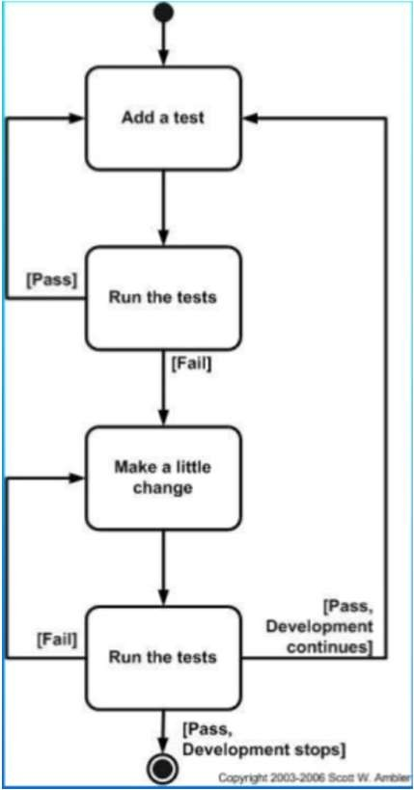
JUnit – Introduction
▪ | Open source testing framework for Java
▪ | Useful for running repeatable tests
▪
▪ | Promotes the idea of first “testing | then
 | coding”
▪ Follows a Test Driven Development Approach
Is now ported to different languages
The testing code is embedded into the main Java program and by using the assert statements, and the programmers knowledge on the expectant result, we can test each component of the project

Slide 4
Junit features – Part 1
Open source framework, which is used for writing and running tests.
Provides annotations to identify test methods.
Provides assertions for testing expected results.
Provides test runners for running tests.
JUnit tests allow you to write codes faster, which increases quality.
It is elegantly simple. It is less complex and takes less time.
Notes:
JUnit Annotations is a special form of syntactic meta-data that can be added to Java source code for better code readability and structure. Variables, parameters, packages, methods and classes can be annotated. Annotations were introduced in Junit4, which makes Java code more readable and simple.

Slide 5
Junit features – Part 2
JUnit tests can be run automatically and they check their own results and provide immediate feedback. There's no need to manually comb through a report of test results.
JUnit tests can be organized into test suites containing test cases and even other test suites.
Shows test progress in a bar that is green if the test is running smoothly, and it turns red when a test fails.
Refs:
https://www.tutorialspoint.com/junit/junit_overview.htm
https://www.javatpoint.com/junit-tutorial
https://www.youtube.com/watch?v=mqT2mkNhveo
https://www.youtube.com/watch?v=WSFpd48aJ3s

Slide 6
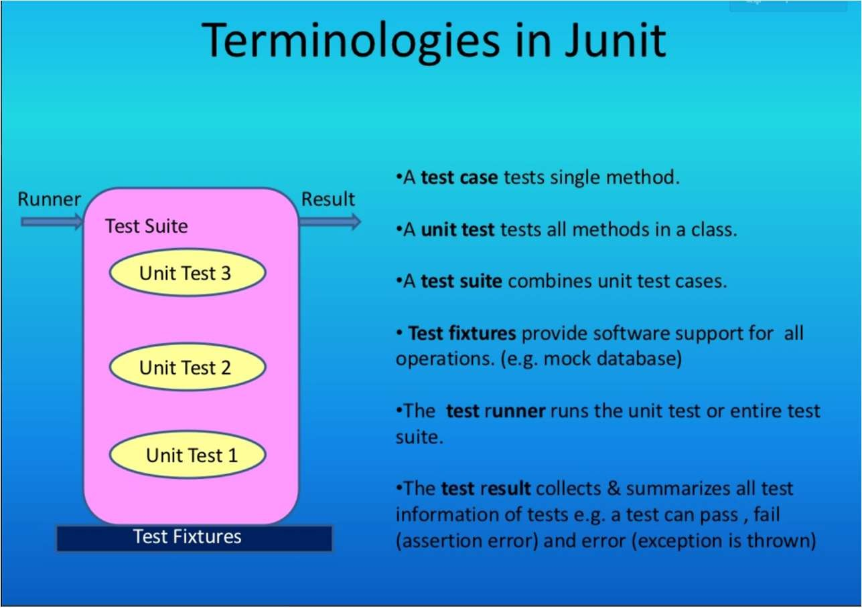

Junit Terminologies

Slide 7
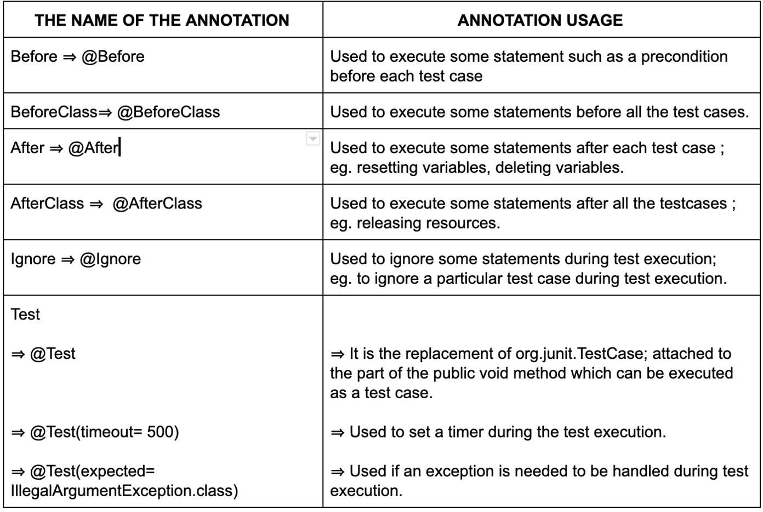
Junit Annotations

Slide 8
Junit - Pros and Cons
Advantages
JUnit is the de facto standard library for unit testing in Java JUnit is supported out of the box by all major IDEs
Separate class loaders for each unit test to avoid side effects
Provides methods like setUp and tearDown for standard resource initialization.
setUP invoked before each test method and is typically used for creating and configuring the system under test.
Teardown test cases are used to perform post test execution actions, for example, to delete test data generated during test execution.
Set of assert methods to check results of tests
Integration with popular tools such as Ant and Maven (build tools provided by Apache) and IDEs like Eclipse and Jbuilder
Disadvantages
Cannot do dependency testing
To make sure a certain number of test methods have completed and succeeded before running more test methods.
Another tool known as TestNG allows this
Not suitable for high level testing
Large test suites
Cannot test various JVMs at the same time

Slide 9
JMeter – Introduction
Open source Java desktop application with a GUI that was developed by the Apache Software Foundationx
Primarily used for load testing functional behaviour and measuring the performance of Web Applications.
Latest version of JMeter is 5.4.1

Slide 10
JMeter – Features
Can run on any environment that supports Java Virtual Machine.
Supports various protocols like HTTP, JDBC, SMTP
Can generate different types of reports
Multi-threading framework which allows concurrent and simultaneous sampling of different functions by many or separate thread groups.
It was originally designed for testing Web Applications only but has since then evolved to test other apps.
Useful in testing the performance of both static and dynamic resources like files, Servlets, Perl scripts, Java Objects, Data Bases, Queries, FTP Servers and more.
Allows for distributed testing and supports plugin addition or removal as per requirements.
▪

Slide 11
JMeter – Components
Thread Group
Number of thread
Ramp-up time
Sampler
HTTP Request
Timers
Constant
Assertions
Response assertion
HTML assertion
JSON assertion
Listeners
Table output
Tree output
https://www.softwaretestinghelp.com/jmeter-components

Slide 12
JMeter - Pros and Cons
Advantages
Disadvantages
▪ ▪ | Free and open source testing tool. Easy to use and GUI oriented and platform independent. | ▪ | Limited to web application testing only with limited protocols.
▪ | Current versions now include | ▪ | Lack of support for JavaScript.
 | support for Load Test, Stress Test, | ▪ | Memory consumption issue
 | Functional Test, Distributed Test, | ▪ | Complex scenario cannot be done
 | all in one tool. |  | using JMeter thread group
▪ | Robust Reporting
▪ | Flexibility and Multi Protocol
 | support.
https://www.youtube.com/watch?v=0dSptr6poxE

Slide 13
MonkeyTalk – Introduction
Mobile app testing automation tool
Powerful for both real and functional interactive tests automation
Supports Smoke tests and Data-driven tests
Can be used to test both Android and iOS apps
Available for Windows, Linux and Mac platforms
Earlier Monkey Talk was provided by Gorilla Logic and was free to download but in 2015 it was bought by Oracle who have not released it yet, so it is not available for download.
Notes:
Smoke testing in software is a quick test done after a build has completed successfully, but before QA fully tests it.

Slide 14
MonkeyTalk features Part 1
Generates results in both HTML and XML formats.
Monkey Talk scripts are highly readable and easy to understand.
It provides Junit reporting
It supports Keyword driven and Data-driven concepts.
Monkey Talk works with Emulators, Simulators, Tethered and Actual Hardware devices

Slide 15
MonkeyTalk features Part 2
Provides record and playback
Has an inbuilt emulator
Can be used to validate controls, images, text or any property of an object.
Provides complete gesture support.
Supports linked-in libraries and subprojects
https://www.youtube.com/watch?v=d79ziz5StkY

Slide 16
MonkeyTalk Components
Monkey Talk IDE
Eclipse based tool
Used to record, play, edit and manage test suites
Monkey Talk Agents
Platform specific libraries
Integrated into the application to be tested
Monkey Talk Scripts
Composed of list of actions
3 forms of writing scripts : JavaScript, Tabular and MonkeyTalk
3 Types of scripts (based on forms of passing parameters)
Driven and driver script
Parameterized scripts
Data-Driven scripts

Slide 17
MonkeyTalk - Pros and Cons
Advantages
Disadvantages
▪ Cross platform.
▪
▪ Installing the agent into app’s
Simple and easy readable and
to learn, easy to
source code is necessary and is platform specific.
▪ No support for HTML5 web apps.
▪
understand scripts.
Supports Keyword Driven and Data Driven concepts.
Provides JUnit reporting
▪
Cannot test embedded web pages.
Testing of games is difficult.
Due to random tests difficult to recreate a bug
May consume lot of time before detecting any bug as there are no predefined tests.
Readable and manageable
object based recordings.
used for testing desktop, web and mobile
▪ Can be
applications.

Slide 18
Summary of the tools
 | Junit | Jmeter | MonkeyTalk
Availability | Open source | Open Source | Open Source till 2015.
User Profiles | Used by Java developers to write and run repeatable tests for each component coded | Load testing functional behaviour and measuring the performance of Web Applications. | Automated Functional tests for mobile applications across Android and iOS.
Type of testing | Unit testing | Performance testing | Smoke testing

Slide 19

THANK YOU
Prof. Venkatesh Prasad
venkateshprasad@pes.edu
Department of Computer Science

